Slide 1
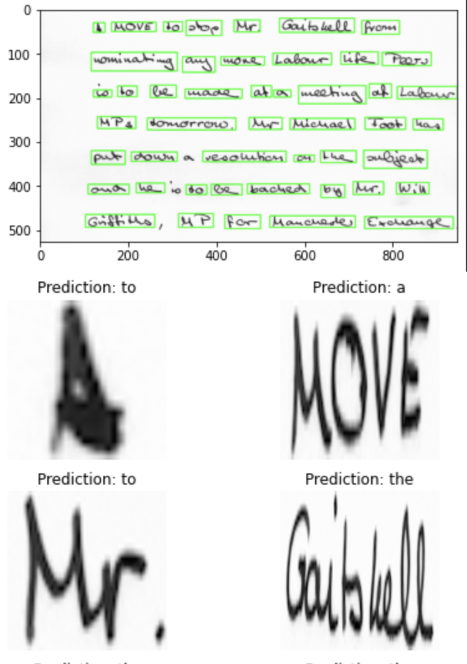

Handwriting Recognition
Heba Abdelrazzak
Ani Chitransh
Ankit Pal
Notes:
Present final project on HR
My teammates

Slide 2
Introduction
Visually impaired people are dependent on other people to help them read handwritten notes.
Our objective is to build a model that will take images of handwritten text and convert it to speech.
Great social impact & can solve accessibility issues.
Notes:
Handwriting Recognition is an old ML problem that is still not completely solved because of its complexity.
Once properly set up, It can be used to digitize different types of documents like historical texts, patient prescriptions, bank records, etc.
We decided to create an application that will help visually impaired people listen to handwritten notes.
We want to make this task easier by providing an accessible application that would take an image of a handwritten note and convert it to lifelike speech.
Currently, there's no good free-to-use application that converts handwritten notes to audio.

Slide 3
Knowledge Gap
There are many models that have attempted to convert handwriting to text using CNN & RNN on the IAM dataset.
Our effort is focused on trying other traditional models to find a better solution.
We used KNN, Random Forest & Naive Bayes to convert handwritten images to text.
Additionally, we are also converting handwritten text to life-like speech.
Notes:
There are many different handwriting styles and there is no perfect model that can convert handwriting to text.
Many attempts have been made to solve this problem using neural networks.
We are trying to explore by testing traditional machine learning models like KNN, Random Forest, Naive Bayes and SVM
We are also trying to add another important component to this project by converting handwritten text to life-like speech since there is no such thing available in the market.
One issue with that is we want to avoid having a robotic voice relay the text, having the voice sound more human-like will be a big challenge.
There are different libraries like AWS Poly and Google TTS that we have used.

Slide 4
Purpose of Study:
Hypothesis
The sole purpose of the study is to test different traditional models and use TTS libraries.
We first need to extract & identify words from the full-page text image.
The next step was to tackle different models to recognize words from images and compare them to already existing methods.
And then finally give a voice to the final reassembled text.
Notes:
The sole purpose of this project is to test different traditional models that are not commonly used for handwriting recognition, as well as to try & test different TTS libraries.
Since we are using handwritten notes, the first question is to extract & identify words from the full-page text image.
The next step we needed to tackle was how we can use different models to recognize words from images and compare them to already existing methods.
Also, we are reassembling the words into the final text and converting the text into life-like speech.
So the next question would be to define a voice for the final text.

Slide 5
Methods & Materials
Data Source : https://fki.tic.heia-fr.ch/databases/iam-handwriting-database
This database contains handwritten English text in various formats that can be used to train and test handwritten text recognizers.
It contains unconstrained handwritten text forms, scanned at a resolution of 300 dpi and saved as PNG images with 256 gray levels.
Also, it offers handwriting pages, which have also been extracted into lines and words using an automatic segmentation scheme.
Notes:
The IAM Handwriting Database contains handwritten English text in various formats that can be used to train and test handwritten text recognizers. The database has documents that contain unconstrained handwritten text forms, scanned at a resolution of 300 dpi and saved as PNG images with 256 gray levels.
The dataset contains 115,320 words contained in 1,539 pages of handwritten text, by 657 unique writers.

Slide 6
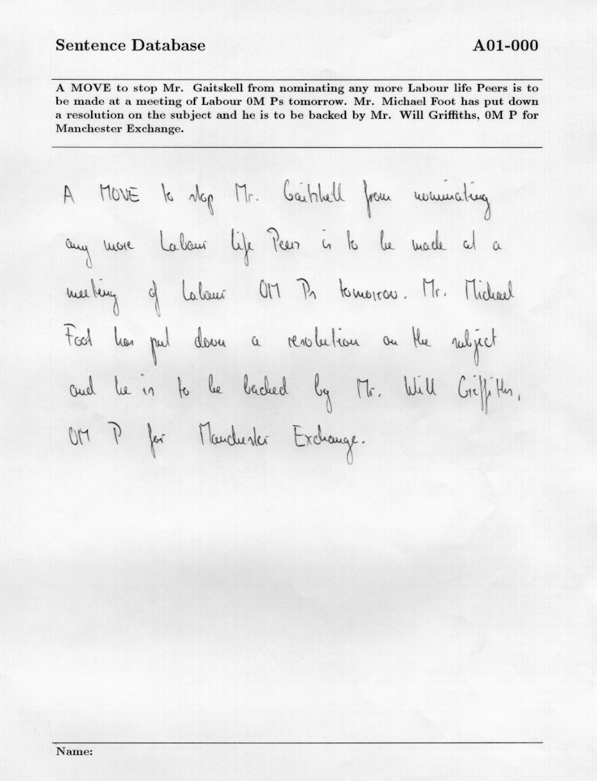
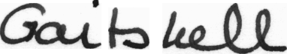
Sample Image :
Notes:
The dataset offers handwriting pages, which have also been extracted into lines and words using an automatic segmentation scheme.
We have decided to use the full pages of the handwritten notes as a dataset since that is the most similar to what we would be faced with, in a real-world use case.

Slide 7
Analysis
We used the word segmented images from the dataset
Reducing the dataset size (because of limited resources)
Approach 1:
Choosing the most common words from the dataset
We chose the 100 most common words
Approach 2
Choosing a list of handpicked words from the dataset
Choosing a maximum number of images per word
We chose 200 images per word
Mapping the image to the label of the selected word.
We encoded the labels to map each label to a number
Image Processing
We read the image in grayscale.
We resize all images to a fixed size
We converted each image to an array and normalized it.

Slide 8
Analysis
Continued….
We trained the dataset using the K cross-validation method with k=5 with different models:
Naive Bayes
Gaussian
Multinomial
Random Forest
Number of trees = 100
K Nearest Neighbors
k = 5
p=2 Euclidean Distance
Support Vector Machines
Poly kernel
For the demo, we did word segmentation of the image using Opencv and predicted the text using the best model.
We converted the predicted text to voice.

Slide 9
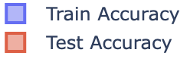
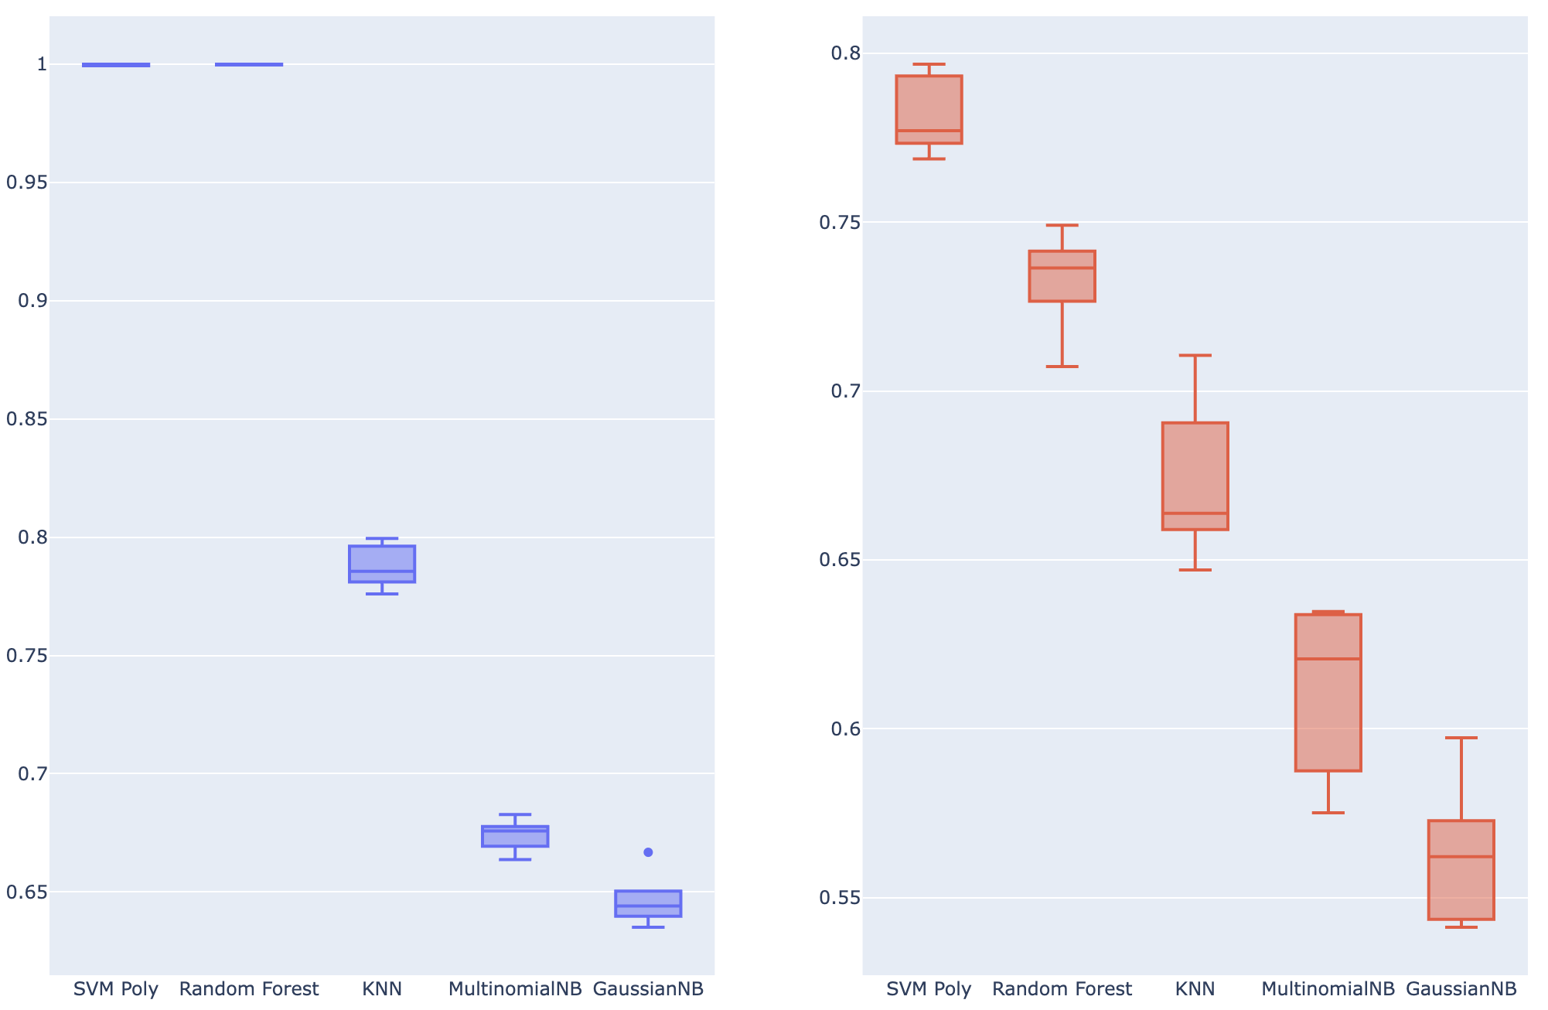
Results :
Accuracy comparison of all the models
Notes:
Best performer
Random forest seemed to perform well with train data but it was overfitting and did not perform as well with test data
Worst performer

Slide 10
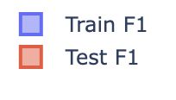
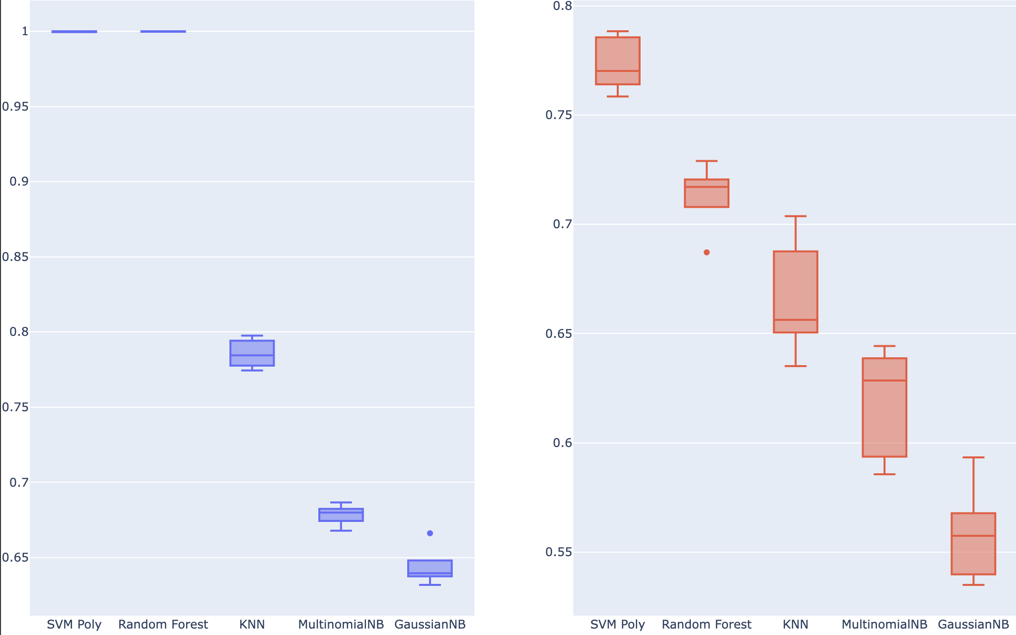
Results :
F 1 score comparison of all the models
Notes:
Since the classes are unbalanced it’s important to consider other performance measures
F1 score is balancing precision and recall on the positive class while accuracy looks at correctly classified observations both positive and negative

Slide 11
Discussion
We can use image to sequence model that does not use image segmentation. Replicating Full Page Handwriting Recognition via Image to Sequence Extraction
We need lots of word images - hard to obtain these images and make sure every word is included, and then it would be computationally expensive to train the model.
All the life-like speech libraries are paid.
Traditions ML models do not work really well.
Notes:
Character segmentation is more accurate than word segmentation but it’s very hard to achieve. We can use image to sequence model that does not use image segmentation.
There has been some research done by Turnitin about image to Sequence models rather than using image segmentation techniques for handwriting
Turnitin is a website where students can submit their handwritten assignments and it’s automatically reviewed
Models that include lots of word images would be computationally expensive and not easy to replicate.
However not having enough word images negatively influences the model performance
There are no free-to-use life-like speech libraries
Traditional machine learning models performance is comparatively worse than neural networks.

Slide 12
Demo
Notes:
The image that we will use to recognize the handwritten text
Our model detects each word in the image and then converts the full page into speech
It prints a sample of words with the predicted text
Then the text is spoken by a robotic voice
As you can see the prediction is not very good because we used a limited set of training words
(human like)
We also attempted the same image with a human-like voice, however this is only a free trial of AWS Polly
(easy ocr)
We used the same image to check the performance of the popular python package easy OCR
Even though our model performance was not great, easy OCR performed even worse

Slide 13
Future Work
The traditional models do not perform well so using Neural network models can probably increase the performance.
We have a lot of images to select for each word, sometimes no images at all, so trying Image to Sequence architecture should be preferred.
Emotions are important when you are reading something to make it clear like sad, happy or excited. Introducing emotions to words can be a wide aspect to look at.
We can always take a look at the large & synthetic datasets to work on more images.
Notes:
Traditional machine learning models don’t perform well so we can use Neural networks to increase the performance.
Rather than using image segmentation, we can try using image to sequence model
Emotions are important when you are reading something to make it clear like sad, happy or excited. Introducing emotions to the speech can be a new aspect to look at.
Sometimes the handwritten text may not be identified by the models, like different styles of handwriting, or spelling mistakes
We can always take a look at the large & synthetic datasets to improve performance and use language models to fix mistakes.

Slide 14
Conclusion
We did handwriting recognition using different traditional models and image segmentation. The model with the best performance was Support Vector Machines.
This model is easy to replicate and makes it easy to understand.
The image segmentation approach requires a lot of training data for each word, in order to predict accurately. It does not perform well when the data changes for e.g. curved text, change in height and width, and formatting and indentation is not always preserved.
So, Image to Sequence architecture with Neural Networks implementation seems to be a better method, however it may not be as easily replicated as it is more complex and requires more computational resources.
Notes:
We did handwriting recognition using different traditional models and image segmentation.
The model with the best performance was Support Vector Machines.
This study is easy to replicate and makes it easy to understand.
The image segmentation approach requires a lot of training data for each word, in order to predict accurately.
It does not perform well when the data changes for example curved text, change in height and width
Image to Sequence architecture with Neural Networks implementation seems to be a better method
however it may not be as easily replicated as it is more complex and requires more computational resources.

Slide 15
Thank you!

